Slide 1
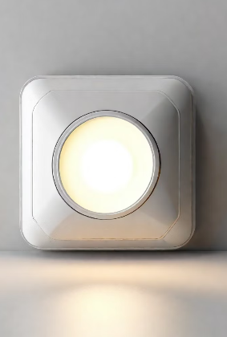

Light Sensors: For Domestic Use

Slide 2

Background research
Does the kind of product already exist on the market and who manufactures it.
What are the main features of such a product.
Use cases
Research problem in other’s product

Slide 3
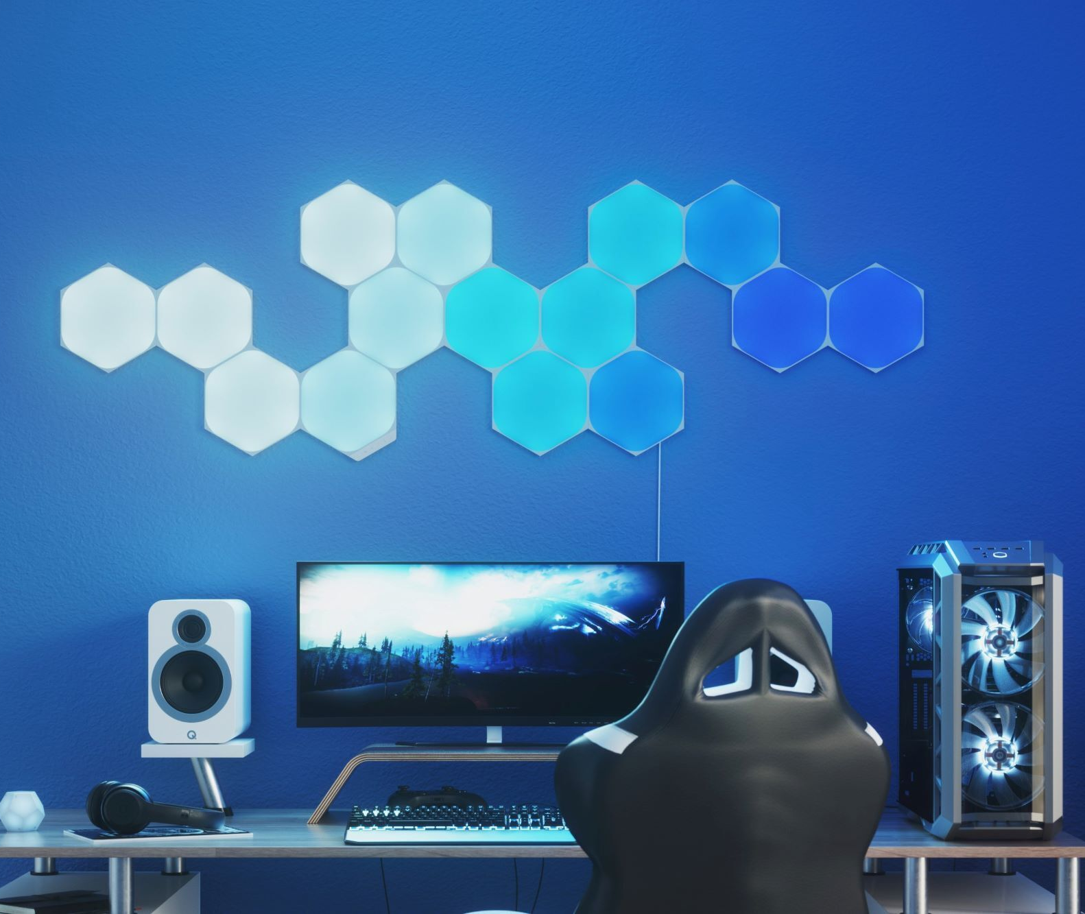
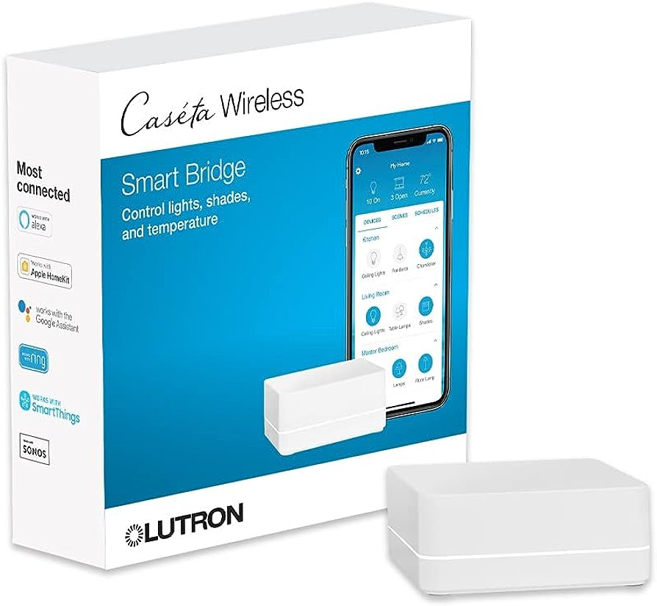
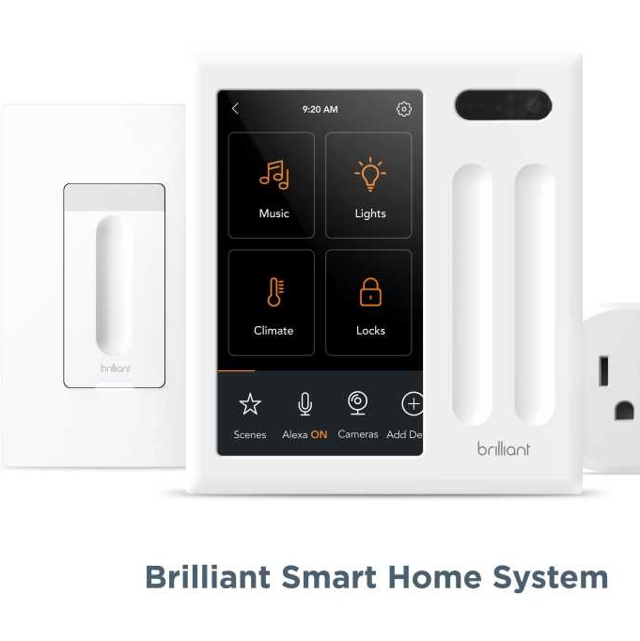
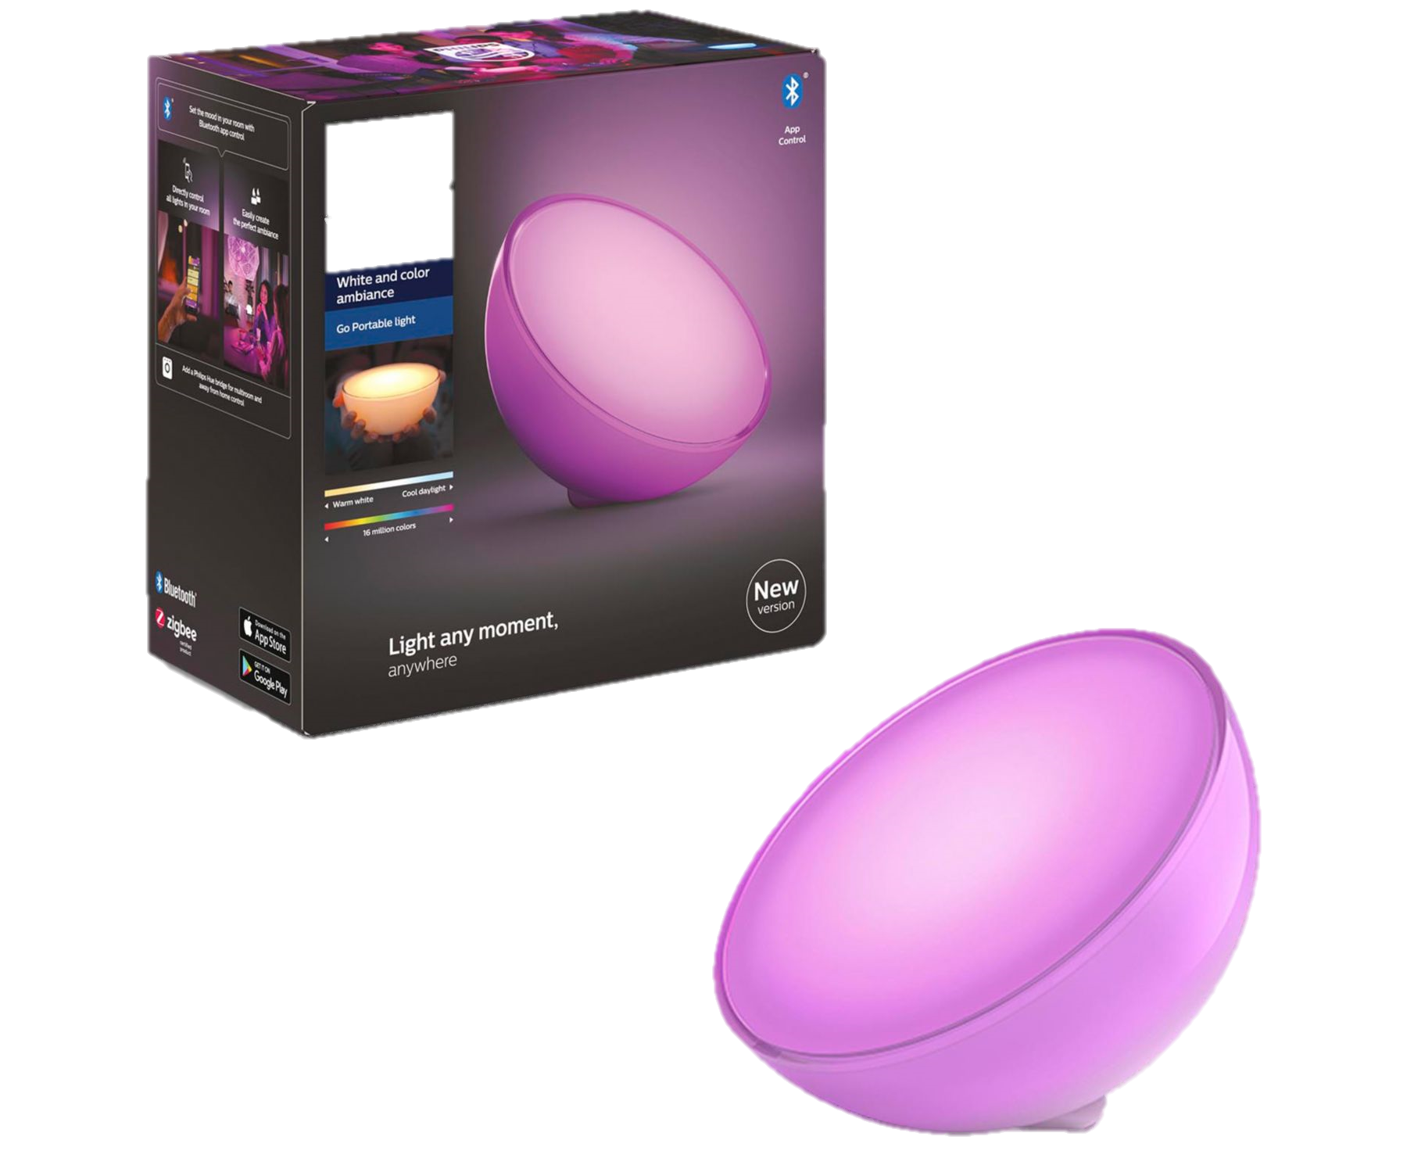
Some Notable Companies with the similar product:
Nanoleaf: Offers innovative lighting shapes and panels for creating unique lighting experiences, with app control and music sync features.
Lutron Caseta: A premium smart lighting system known for its reliability and seamless integration with high-end home automation systems.
Brilliant: Offers smart switches and dimmers that replace existing wall switches, adding smart lighting control without changing bulbs.
Philips Hue Go and Signe: These portable lamps include white and color LED lights, built-in dimmer, and an ambient light sensor that automatically adjusts brightness for optimal ambiance.

Slide 4
Problem in their system
Requires their own PWM light bulb
Incompatibility issues
Required company-based app for operation

Slide 5
Features
Adaptive Brightness according to user’s time schedule
Voice controllable light system
Mobile control for Light
Energy monitoring

Slide 6

Research on UN Sustainability Goals
What are the sustainability goals design to achieve.
Which goals are relevant to your product and why.

Slide 7
Sustainable Development Goal Achieved
Affordable and Clean Energy (SDG 7):
The project can contribute by optimizing energy usage through features like automation, timers, and energy monitoring, promoting energy efficiency.
Sustainable Cities and Communities (SDG 11):
By providing smart lighting solutions, the project contributes to creating more sustainable and energy-efficient urban environments.
Industry, Innovation, and Infrastructure (SDG 9):
The project represents an innovative use of technology (IoT) for enhancing infrastructure (smart lighting systems) in both residential and commercial spaces.

Slide 8
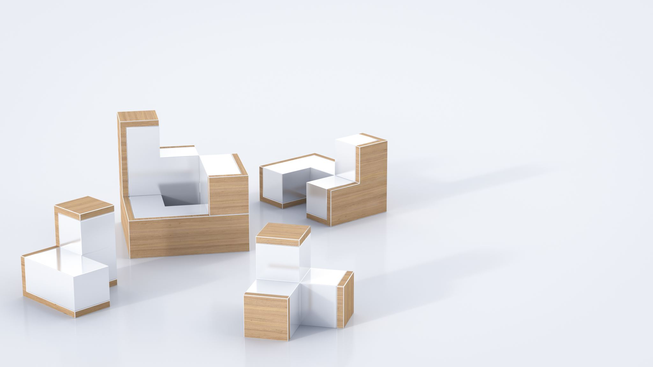
Product designs
Basic logic designs are a great way to describe the functionality of a new product.
What kind of sensors will your product employ and how will they be connected together.

Slide 9
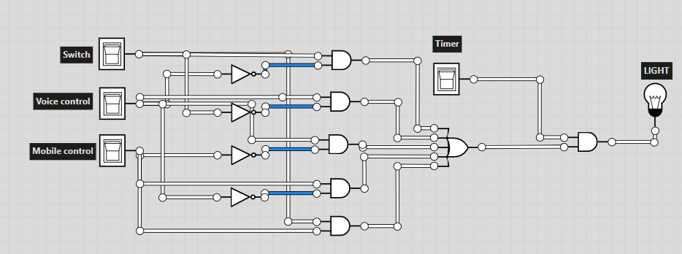
Boolean Algebra: $\left( \overline{M}S+ M\overline{S}+M\overline{V}+V\overline{M}+VS\right)T$
Switch | Mobile | Voice | Timer | Output
0 | 0 | 0 | 0 | 0
1 | 0 | 0 | 0 | 0
0 | 1 | 0 | 0 | 0
1 | 1 | 0 | 0 | 0
0 | 0 | 1 | 0 | 0
1 | 0 | 1 | 0 | 0
0 | 1 | 1 | 0 | 0
1 | 1 | 1 | 0 | 0
0 | 0 | 0 | 1 | 0
1 | 0 | 0 | 1 | 1
0 | 1 | 0 | 1 | 1
1 | 1 | 0 | 1 | 1
0 | 0 | 1 | 1 | 1
1 | 0 | 1 | 1 | 1
0 | 1 | 1 | 1 | 1
1 | 1 | 1 | 1 | 1

Slide 10
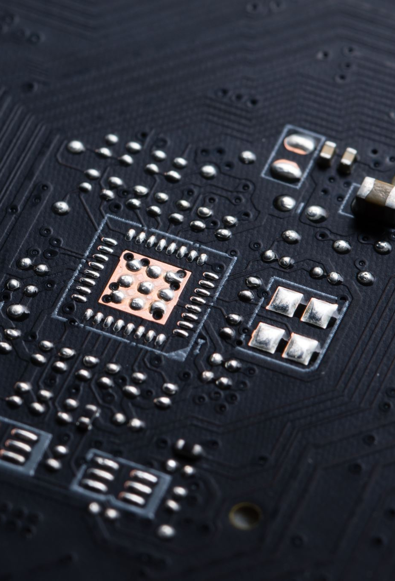
Device / software / sensor used:
Node Mcu: microcontroller with built-in Wi-Fi capabilities(ESP8266)
Current sensor/Voltage sensor
LDR sensor
Real-Time Clock(RTC) module
Blynk App
PWM system bulb or LED strip
Relay module

